Slide 1
Simulating Randomness in Airport Landing Queue
By
Mohamed Azouz
Hadi Hesham
Saif Abd Eflattah

Slide 2
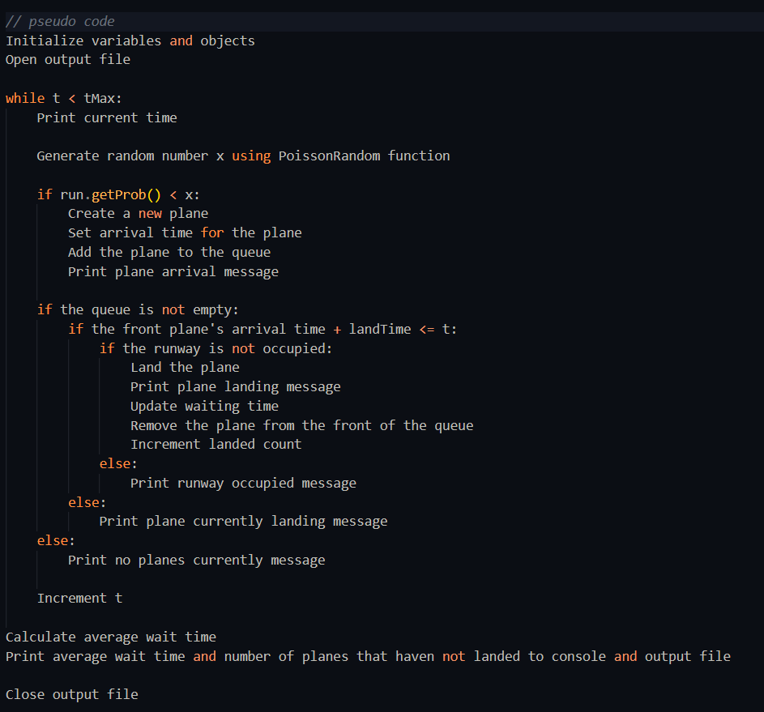
Pseudo code

Slide 3
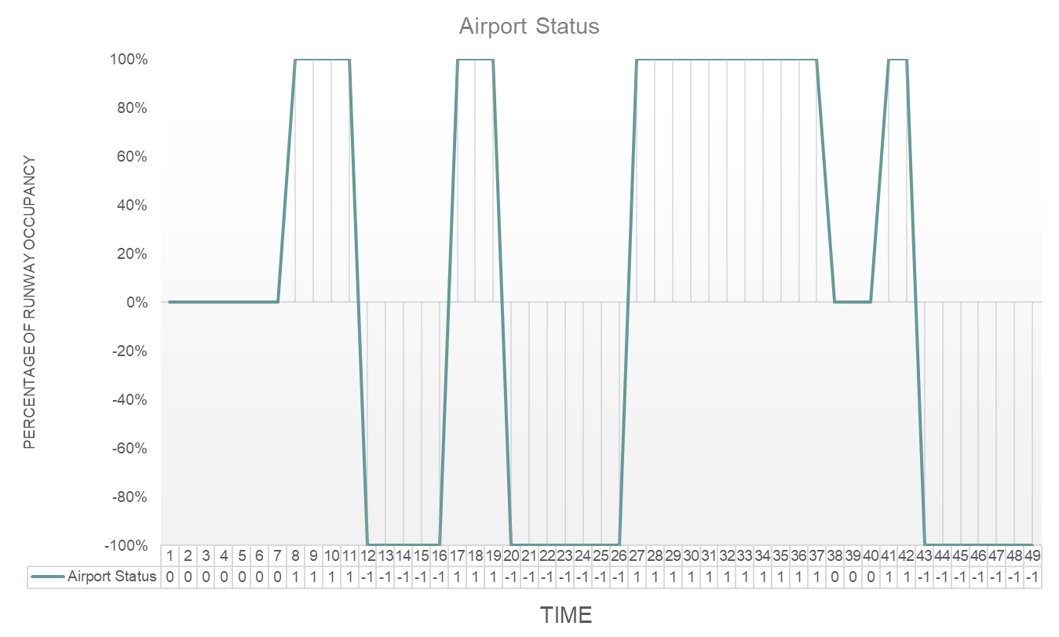
Data specifications

Slide 4
Relationships
The data demonstrates that the runway occupancy is directly related to the arrival rate of planes, the time required for a plane to land (landTime), and the average time between plane arrivals (avgTime). When the arrival rate of planes is higher or the landTime is longer, the runway tends to remain occupied for longer durations, resulting in a higher percentage of runway occupancy. Conversely, when the arrival rate is lower or the time landing is shorter, the runway occupancy becomes zero or negative one (decreases).

Slide 5
Thank You!
Questions?

